Slide 1
Toward the application of an emoji language in augmentative and alternative communication (AAC)
May 4th, 2026

Slide 2
Disclaimers
Any products and systems mentioned in this presentation are provided for educational and illustrative purposes only.
Mention of any specific product, manufacturer, or service does not constitute an endorsement or recommendation by the presenter or their organization. Other comparable products or systems may be available.
The presenters have no financial interest in any product mentioned in this presentation.
Any specific symbols or graphics used in this presentation are illustrative.

Slide 3
Introduction to AAC and its clinical implications
Part 1

Slide 4
What is “communication”?
Transmission of information
Contrasts
  Linguistic vs. non-linguistic
  Verbal vs. non-verbal
Examples
  Speech = linguistic + verbal
  Writing = linguistic + non-verbal
  Gestures = non-linguistic + non-verbal
Verbal communication: very efficient and multimodal
  Communicates the code (language) but also emotions and attitudes by way of prosody
  Visual (prosodic gestures including facial expression)
  Acoustic – audible
  Linguistic

Slide 5
What is Augmentative and Alternative Communication (AAC)?
“All the ways that someone communicates besides talking” (ASHA)
  Narrow view: Includes strategies and tools for individuals with speech or language impairments
  Broad view: Everybody now uses some form of AAC, and one should be aware of pitfalls and responsible use (applicable to HEST)
Helps users communicate when verbal speech is not possible or is insufficient
  External reasons: Noise, multitasking
  Communicator reasons: various conditions, such as cerebral palsy, ALS, autism, stroke, and more
    Example: Stephen Hawking
    Synthesized voice (e.g., Siri on iPhone)

Slide 6
Verbal communication is demanding
In terms of
  Visual processing
  Acoustic processing
  Linguistic processing
  Prosody processing
Keep these requirements in mind when we discuss Emoji mode communication

Slide 7
Typical users of AAC (narrow)
Children with developmental disabilities
  Autism Spectrum Disorders / Conditions (ASD / ASC)
  Down syndrome
Adults with physical disabilities affecting speech
  Cerebral palsy
  Spinal cord injuries
  ALS
Adults with acquired communication disorders
  Aphasia (stroke, traumatic brain injury)
  Neurodegenerative diseases (Parkinson’s disease)
Individuals with temporary impairments
  Surgery affecting mouth or vocal cords
  Dental work

Slide 8
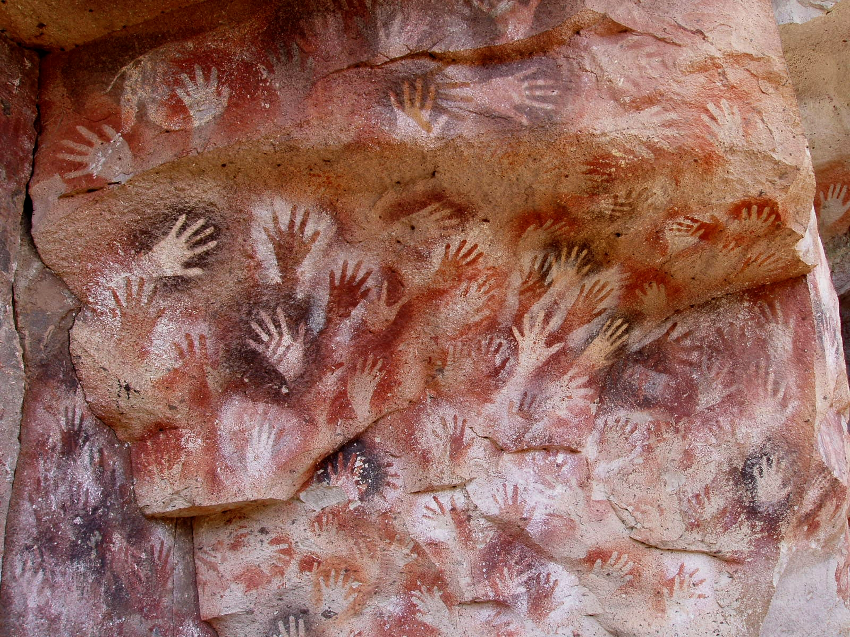
Inherent (“no-tech”) AAC
Hand or bodily gestures
Facial expressions
Pointing
Nonlinguistic vocalization
  Interjections (“hmm”, “oh”)
  Prosody
Image: Mariano (2005) https://commons.wikimedia.org/w/index.php?curid=265811

Slide 9
Physical (low-tech) AAC tools
Paper-based communication boards
  Use of letters, pictures, symbols, or words
  Cost-effective and portable
Manual communication books
  Suitable for individuals with limited fine motor skills
  Example: PECS (Picture Exchange Communication System)
Gestures or sign language
  Often used in combination with other AAC methods
  Requires manual dexterity and fine motor skills

Slide 10
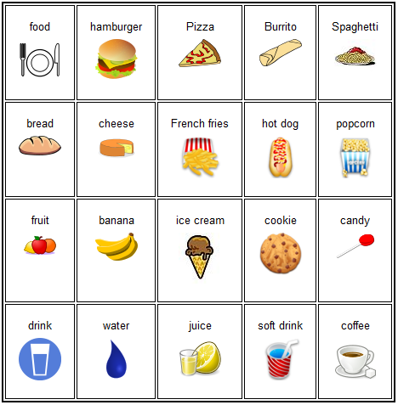
Communication board example
Image: Quadell, CC BY-SA 3.0, https://commons.wikimedia.org/w/index.php?curid=16175928

Slide 11
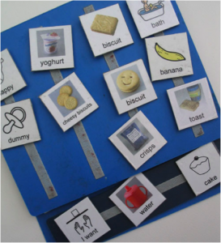
PECS example
Image: https://www.integratedtreatmentservices.co.uk

Slide 12
Digital (high-tech) AAC tools
Speech-generating devices (SGDs)
  Specialized devices or apps that produce speech output.
  Examples: Tobii Dynavox, Prentke Romich Company devices, or apps like Proloquo2Go.
Tablets and smartphones
  Multiple app options such as TouchChat, LAMP Words for Life, or Boardmaker
  Customizable to meet user’s needs
Eye-tracking devices
  Used for individuals with severe motor impairments
  Eye position can select words or symbols via gaze

Slide 13
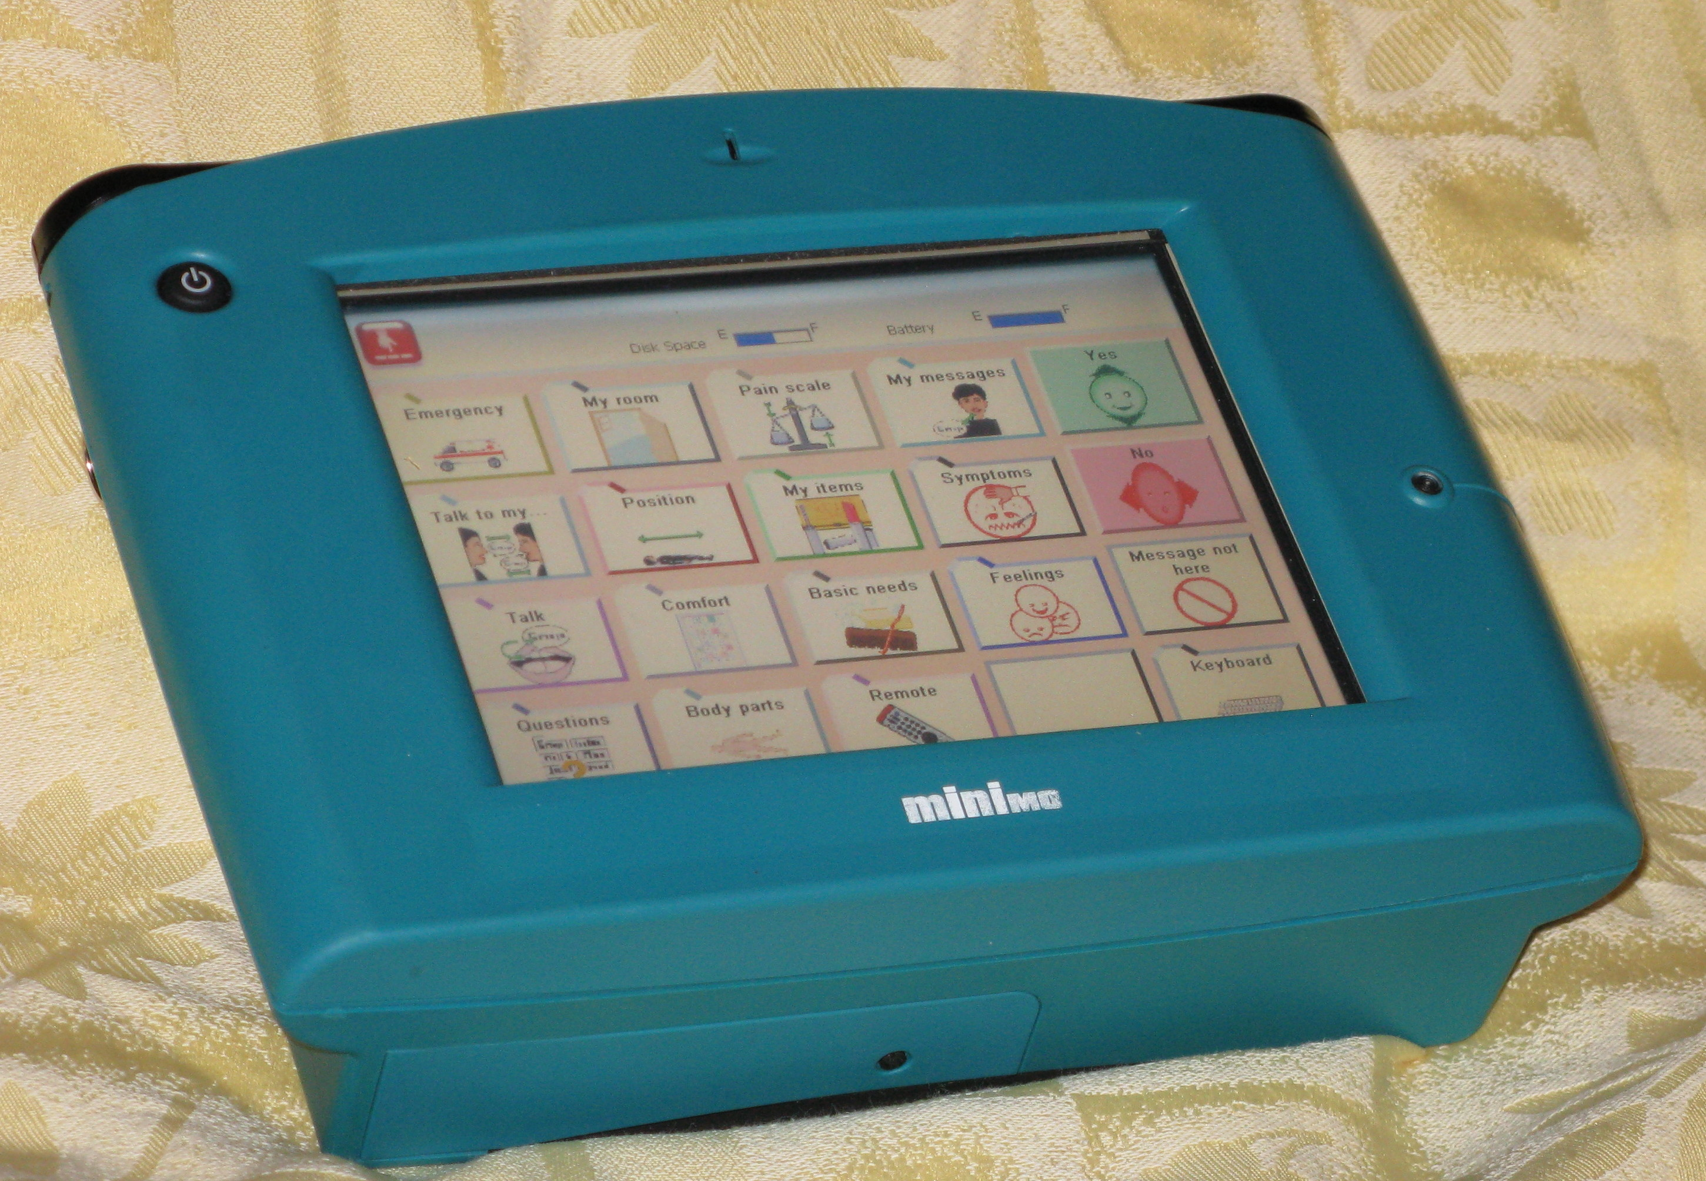
Speech-generating device
Image: Poule, CC BY-SA 3.0, https://commons.wikimedia.org/w/index.php?curid=15787073

Slide 14
General AAC types
Visual
  Pictures
    Simple and intuitive for users with limited literacy or cognitive impairments
    Communicate basic concepts, needs, or emotions
    Examples: PECS, Mayer-Johnson’s Boardmaker symbols
  Symbol-based communication
    Often paired with specific devices or software for more complex communication.
    Examples: Bliss symbols, Minspeak
Audio
  Text-to-Speech (TTS)
    Converts typed text (English) into speech
    Includes customizable voices, speed, and intonation
  Dynamic Speech Generation
    Diverse auditory outputs,
    User-customized voices or different languages

Slide 15
Funding challenges
Medicare & Medicaid
  Coverage varies by state, often requiring extensive documentation and proof of medical necessity
  Strict eligibility criteria (e.g., proof of cognitive function and motor abilities to use devices)
  Not all AAC tools are reimbursed (generally, devices with direct speech output are more likely to be funded)
Private insurance
  Many private insurance plans cover AAC devices, but it often requires an extensive approval process
  Some insurers may only cover basic models or specific brands
State programs and grants
  Some states offer financial assistance or device loans
  Nonprofits (e.g., the United Cerebral Palsy Association) may provide funding or advocacy
School funding
  AAC devices or software as part of an Individualized Education Plan (IEP)
  Impact of funding and DOE cuts
  Special education: scope of practice?

Slide 16
Usability of AAC devices: Conceptual
Complexity
  High-tech AAC devices can be overwhelming for both users and caregivers
  Some users may struggle with abstract concepts, symbols, or language complexity
Customization (making the system one’s own) opportunities in
  Symbol sets
  Layout
  Voice preferences
  Language (input and output)
Learning curve
  Learning how to use AAC systems takes time, and it may require continuous support
  Training requirements for both the user and family members/caregivers

Slide 17
Usability of AAC devices: Physical
Some individuals face challenges in physically interacting with devices, such as difficulty with touch screens, eye-tracking limitations, or limited hand control
Accessibility of the device (e.g., position, interface size, durability) often affects usage and effectiveness
Devices require regular updates and maintenance, especially for high-tech models
Many high-tech AAC devices have short battery lives, creating dependency on constant recharging

Slide 18
Trends in AAC
Smart tech and AI
  Integration with smart home devices (e.g., voice-controlled systems like Alexa or Google Assistant)
  More personalized, context-aware features using artificial intelligence
Expanded interfaces
  Eye-tracking and brain-computer interfaces (BCI) provide new opportunities for those with severe physical limitations
  User-driven design facilitates “ownership” of a customized, intuitive, and flexible system that reflects its user

Slide 19
Audio communication advantages
(“availability” over alternative or absent)
Natural
  Audio systems allow the user to communicate with a human-like voice, which can make conversations more fluid and “natural” compared to pointing at pictures or symbols
  Many speech synthesis systems allow users to adjust pitch, tone, and speed, providing more emotional expressiveness than static graphic systems
Fast
  Audio synthesis allows for faster communication, as it can be spoken out loud, while graphical or symbol systems may take longer for the user to navigate and select an option
  Audio allows users to communicate more complex thoughts or detailed narratives, which may be challenging with pictures or symbols alone
Social integration
  People using audio synthesis can participate in verbal conversations with others
  This promotes inclusion and normalizes communication, which might not be the case with graphical systems, especially in public settings where others may be unfamiliar with AAC

Slide 20
Graphical communication advantages
(pictorial / visual)
Universality
  Symbols and pictures are universally understood and cross the language barrier, even by users with limited literacy or cognitive skills
  Graphic systems are often easier to learn for individuals with cognitive or developmental disabilities
  Symbol-based systems require less reliance on reading or writing, which is beneficial for individuals with limited language skills
Flexibility
  Symbols and images can be tailored to the user’s needs (familiar images, entities, and concepts)
  Virtual board layouts can be modified to facilitate communication (groupings, folders, visual layout)
Discreetness
  Silent communication with caregivers
  Avoid stigmatization or drawing attention due to synthetic voice

Slide 21
Developing a graphical syntax
Part 2

Slide 22
Emoji – basics
Pictograms / logograms used in digital text
Origin
  Japanese e (絵 “picture”) + moji (文字 “character”)
  Coincidentally related to English words “emotion” and “emoticon”, such as :)
Frequently used in modern digital communication to convey:
  Gestalt concepts
  Emotional tone (original intent)
    Replaces spoken prosody; Greek prosodia (προσῳδία) , the “music” of speech and language (Boutsen, 2003)
  Shades of meaning (useful in neurodiverse communities)
  Culture-specific concepts

Slide 23
___grams
Pictogram
  Conveys meaning through resemblance to a physical referent
  Examples: Hazard pictograms, computer icons
Logogram
  Represents a semantic component of a language
    Morpheme
    Word
  Examples: Chinese characters, Egyptian hieroglyphs
Ideogram
  Represents a specific concept or idea, but not a specific word
  Examples: Numerals, mathematical symbols, typographical symbols
There are many edge cases and intersections

Slide 24
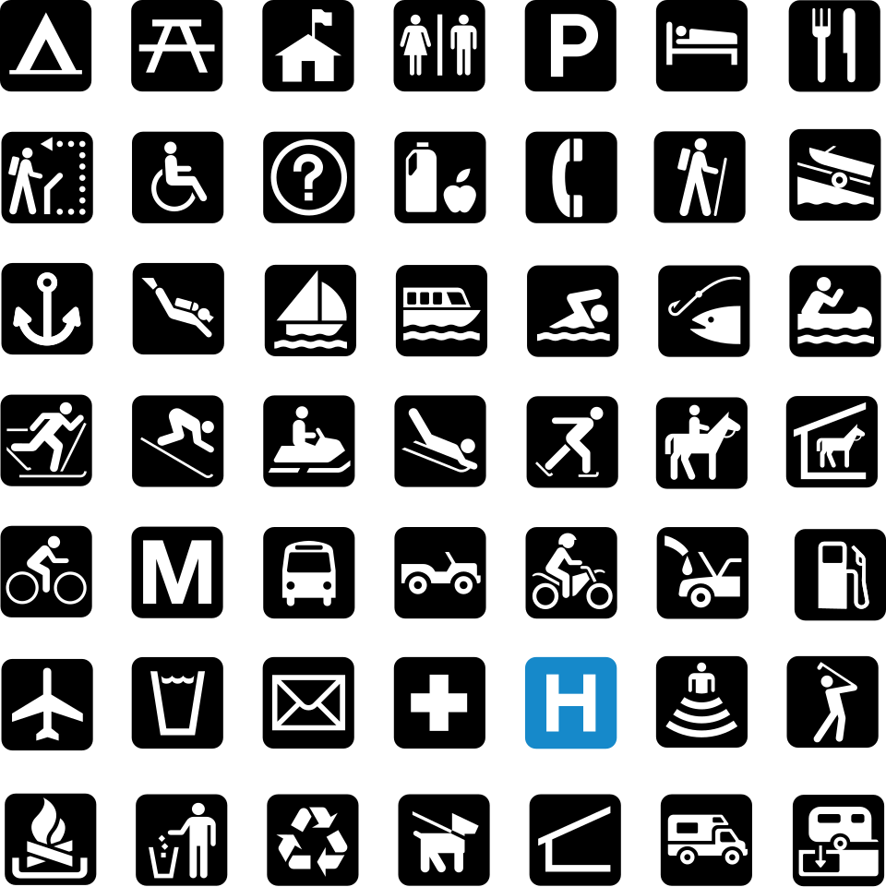
Pictograms: US National Park Service
Image: http://www.nps.gov/hfc/carto/map-symbols.htm

Slide 25
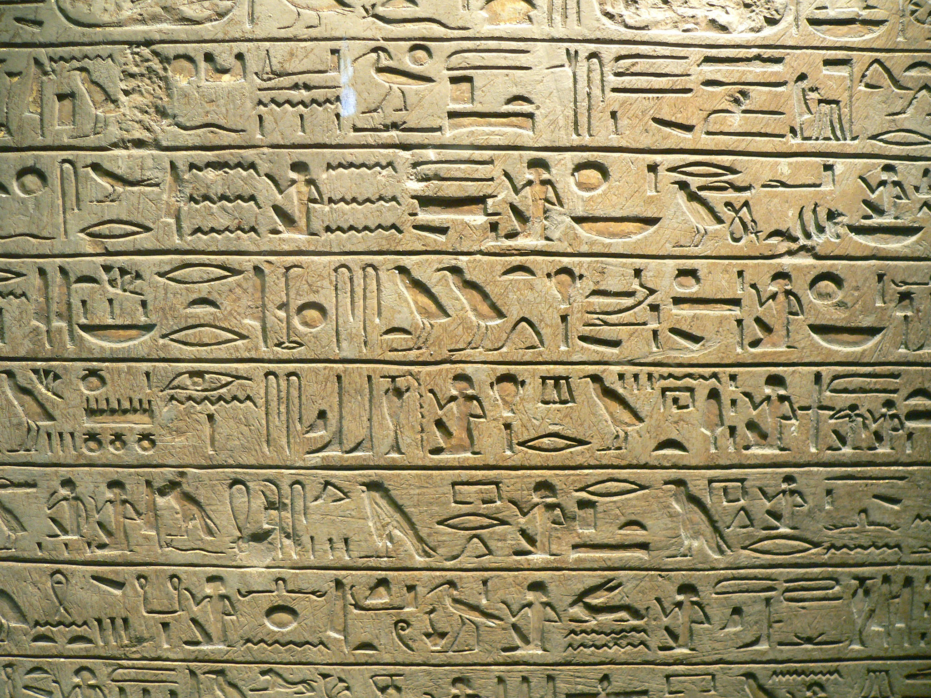
Logograms: Hieroglyphs
Image: Clio20, CC BY-SA 3.0, https://commons.wikimedia.org/w/index.php?curid=592581

Slide 26
Ideograms
€
©
+
-
×
÷
§
&
1
2
3

Slide 27
Emoji – further details
Do not constitute a formal language in and of themselves
  Limited compounding / modifying
  No phrase structure or embedding
  One-shot “utterances”
  Ad-hoc rules, if any
Technical and licensing questions for images
  What constitutes “proprietary” vs. “open source”?
    Compare to PCS® by Tobii Dynavox
  Effect of font choice (contrast / colors)
  Vector vs. raster images (low vision)

Slide 28
Key properties of language
Abstraction / arbitrariness
  There is no inherent reason that a dog (referent in the real world) should be represented by the specific sequence of sounds / letters “DOG”
Displacement
  Can talk about past, future, negation, hypotheticals
  Could, should, would, if/then, what if?
Productivity
  “Infinite use of finite means” (von Humboldt, Chomsky)
  Can combine a finite set of elements into potentially infinite novel sentences
Embedding
  Nest phrases within other phrases
  Relative clauses & modifiers

Slide 29
How to develop a “graphical language”?
Given
  Lots of “noun”-like objects (emoji, images)
  Linear layout ability (composing text)
  Spacing & punctuation (separate propositions or constituents)
Goal
  Something beyond “English with pictures”
  Avoid English-specific complexities (irregular verbs, conjugations, agreement, etc.)
  Put as much content into the symbols, and minimize “baked-in” rules to learn
Need
  Linkage rule(s), possibly requiring a small number of specific symbols
  Ordering rules
  Interpretation

Slide 30
Advantages of nouns
Most commonly borrowed lexical category
More “concrete”
More readily acquired
Can convey actions and states with appropriate morphology
  “walk” → “walking”
  “slow” → “slowness”
Almost universally an “open class” of words
  Open class – can admit new elements (nouns, verbs, adjectives)
  Closed class – restricted membership (prepositions, articles)

Slide 31
Semantic roles
Examples
  Agent = who/what performs or is responsible for the action
  Patient = who/what receives – or is affected by – the action
  Theme = referent of action without state change (“about what”)
  Time = when
  Location = where
  Reason = why
  …
Common implementations in languages
  Prepositions / postpositions
  Case systems
  Relational nouns

Slide 32

Expressing propositions through linkage
Well established in STEM fields
  Mathematical equations
    $y=mx+b$
  Variable assignment
    let player_x = 10;
  Function calls
    drawBox(x=10, y=20, width=50, height=25);
  Object properties (e.g., JSON, JavaScript Object Notation)
    {
    agent: "my friend",
    event: "walking",
    location: "park",
    time: "yesterday",
    instrument: "cane",
    …
    }
A
B

Slide 33
The default “operator”
“There is” / “there exists”
  Present tense
  Positive
  Indicative
Establishes
  Presence of object
  Existence of state
  Occurrence of an event
Transcends human language and includes animal communication
  “threat”
  “food source”
  “mate”
  “predator”

Slide 34
Linkage to operator
Steps
  Create a new role for “event” / “state” / “situation”
  Define a simple symbol for this role
  Assign this role to the thing that is happening to express a proposition
X
“X is happening”
“There is (a/an) X”

Slide 35
Assignment Grammar
A “proposition” is defined as the assignment of a constituent to a semantic role
  Example 1: location = park
  Example 2: time = now
A “sentence” is defined as a sequence of propositions
Topic = first constituent in a sentence (unassigned)
  Common in interlanguages (SVO grammar)
  Topic / comment structure

Slide 36
A first “graphical sentence”
“Rain is happening”
“There is rain”
“It’s raining”

Slide 37
A first “graphical question”
what?
?
“What is happening?”
(universal question word)

Slide 38

Adding topics / subjects
“Topic” is also an (implicit) semantic role
Paraphrased with “as for” or “regarding”
Example 1:
  “as for me, eating is happening” → “I am eating”
Used in many languages including Japanese, Korean, etc.
I/me
eating
①
you
eating

Slide 39
Adjuncts
Characteristics
  Add additional information to a sentence
  Not grammatically necessary (may be removed without causing errors)
  May be reordered to better reflect information flow, or even included as afterthoughts
  Facilitate enriching comments in topic-comment structures
Examples in English
  Prepositional phrases
  Adverbs of place and time
Usage in Assignment Grammar
  Every proposition is an adjunct

Slide 40


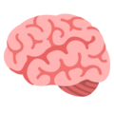



Example adjuncts
location
USA
reason
what?
???
?
“in the United States”
“for what reason?”
“why?”
(wh- in situ)
origin
Japan
time
past
“from Japan”
“in the past”
“before”

Slide 41
Adjuncts can form complete sentences
I/me
origin
USA
①
“I am from the US.”
you
origin
what?
?
“Where are you from?”

Slide 42
Multiple adjuncts combine to refine meaning
you
eating
time
what?
?
“as for you”
“eating is happening”
“at what time?”
“When are you eating?”

Slide 43

Multiple adjuncts combine to refine meaning
I/me
running
location
park
①
“as for me”
“running is happening”
“at the park”
“I am running in/at the park”

Slide 44

Complex questions via multiple adjuncts
you
eating
patient
reason
???
?
“as for you”
“eating is happening”
“to (a/the) mushroom(s)”
“for what reason?”
Why are you eating mushrooms?

Slide 45
Additional topics handled by Assignment Grammar
Compounding
Relative clauses
Tense
Mood
  Negation
  Conditionals
  Hypotheticals

Slide 46

Questions?
you
“as for you”
“question(s) are happening”

