Slide 1

Analyzing Nested and Repeated Measures Data with Linear Mixed-Effects Models
Dr. Giovanna Del Sordo
College of HEST
Quantitative Methods Workshop Series
November 7th, 2025

Slide 2
Learning Outcomes
Understand what are linear mixed-effects models: Able to explain when and why mixed-effects models are used and distinguish them from traditional methods such as ANOVA and regression.
Specify and fit models using R: Gain hands-on experience building mixed-effects models using R, including random intercepts and slopes, and interpreting model output.
Evaluate and compare models: Learn how to assess model fit, compare competing models, and apply appropriate criteria (e.g., likelihood ratio tests, AIC/BIC).
Report and visualize results effectively: Clearly present mixed-effects model results in research reports and visualizations, following best practices for transparency and reproducibility.

Slide 3
When to use Linear Mixed-effects Models (LMMs)?
Repeated data: Data that are not independent.
Hierarchical or nested data: Observations grouped within higher-level units (students within classrooms, patients within hospitals, items within participants).
Unbalanced or missing data: Different numbers of observations per participants, missing trials or time points.
Continuous dependent variables: Reaction times, accuracy…

Slide 4
Why not use Repeated Measures ANOVAs?

Slide 5
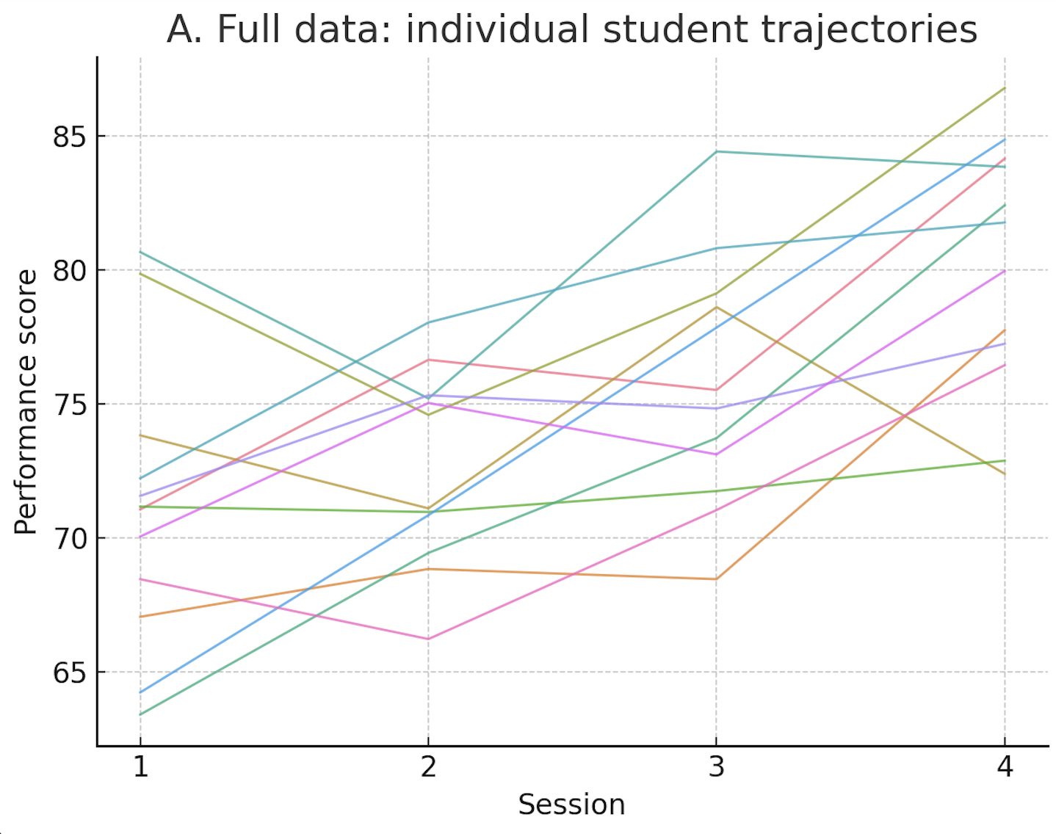
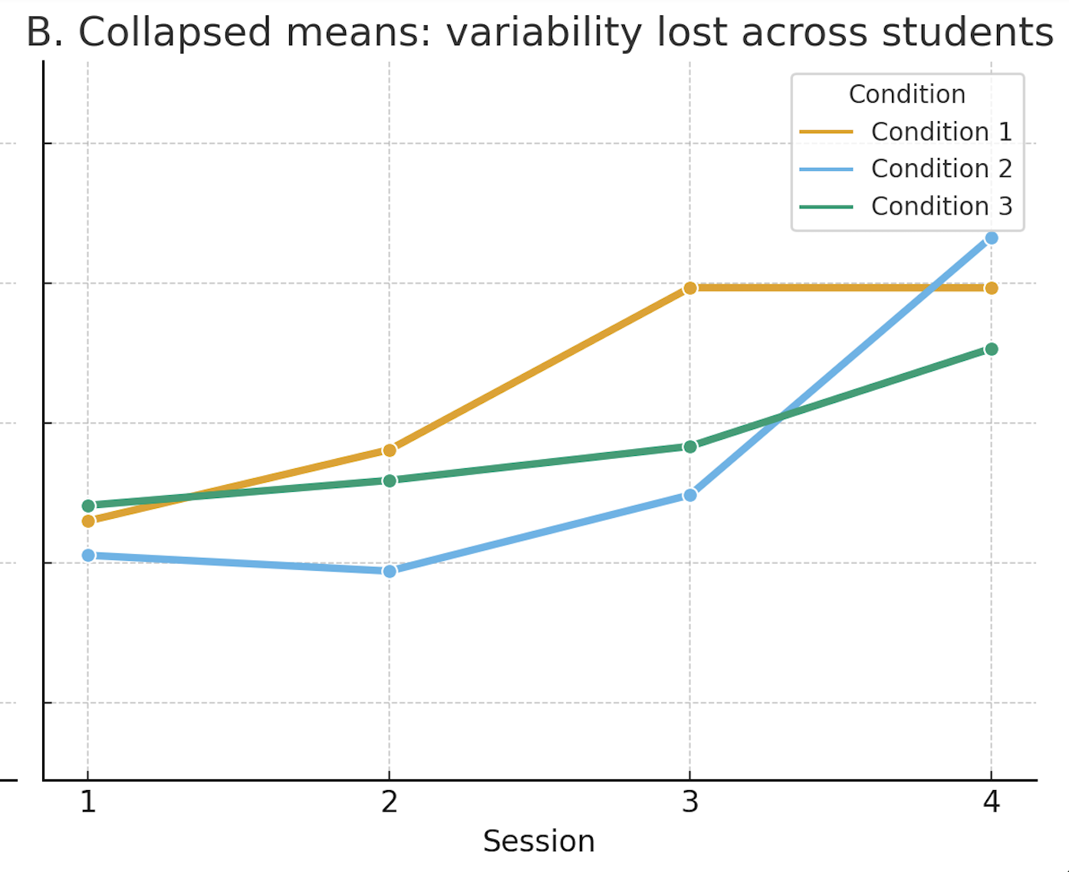
What’s wrong with Repeated Measures ANOVAs?
Loss of within- and between-subject variability due to data aggregation.

Slide 6
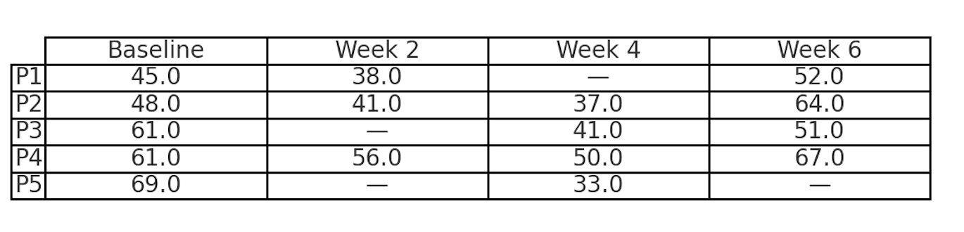
What’s wrong with Repeated Measures ANOVAs?
Missing observations are deleted via listwise deletion

Slide 7
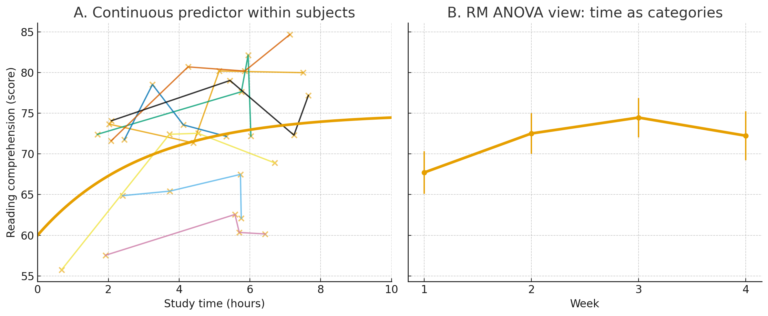
What’s wrong with Repeated Measures ANOVAs?
The independent variables must be categorical

Slide 8
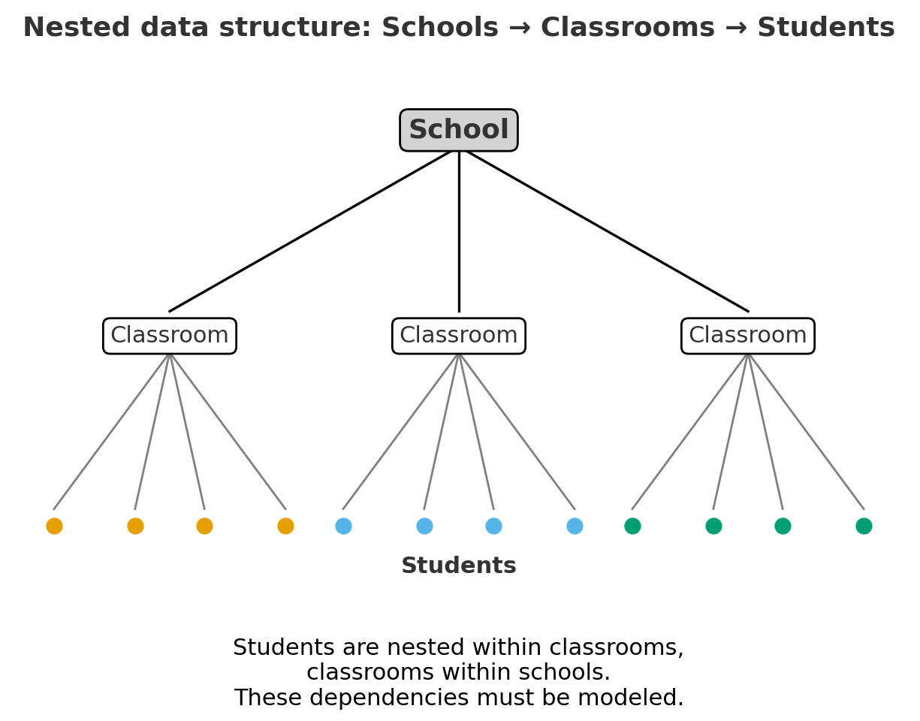
What’s wrong with Repeated Measures ANOVAs?
Nested structures cannot be modeled
Underestimate variability.
Inflate Type I error rates.
Lose insight into group-level effects.

Slide 9
Why use Linear Mixed-effects Models (LMMs)?
Repeated-measures ANOVA | Linear Mixed-effects Models (LMMs)
Requires data aggregation | Uses trial-level data (retains within- and between-subject variability)
Excludes participants with missing data | Handles missing data without case deletion
Predictors must be categorical (binning of continuous predictors) | Handles both categorical and continuous predictors
Cannot model nested data | Accounts for dependencies in nested data
Less statistical power and flexibility | Greater power, flexibility and realism

Slide 10
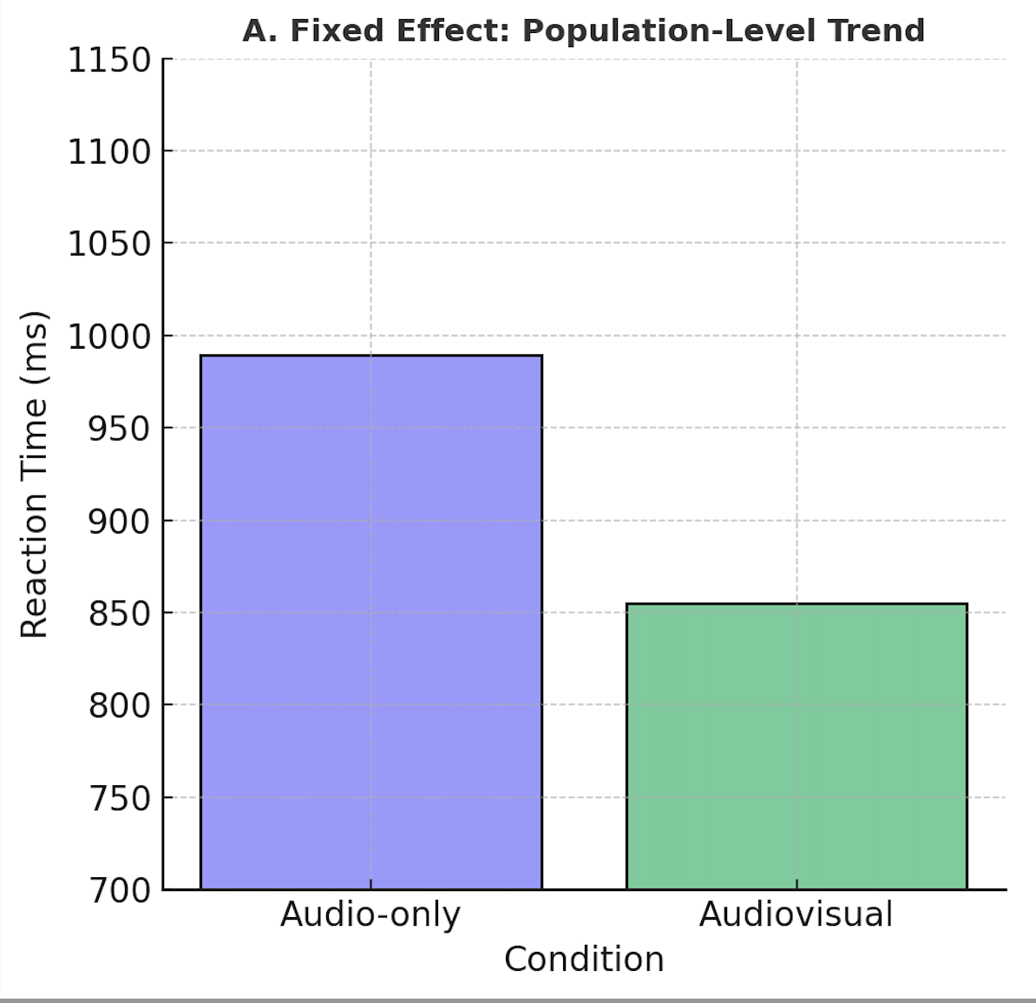
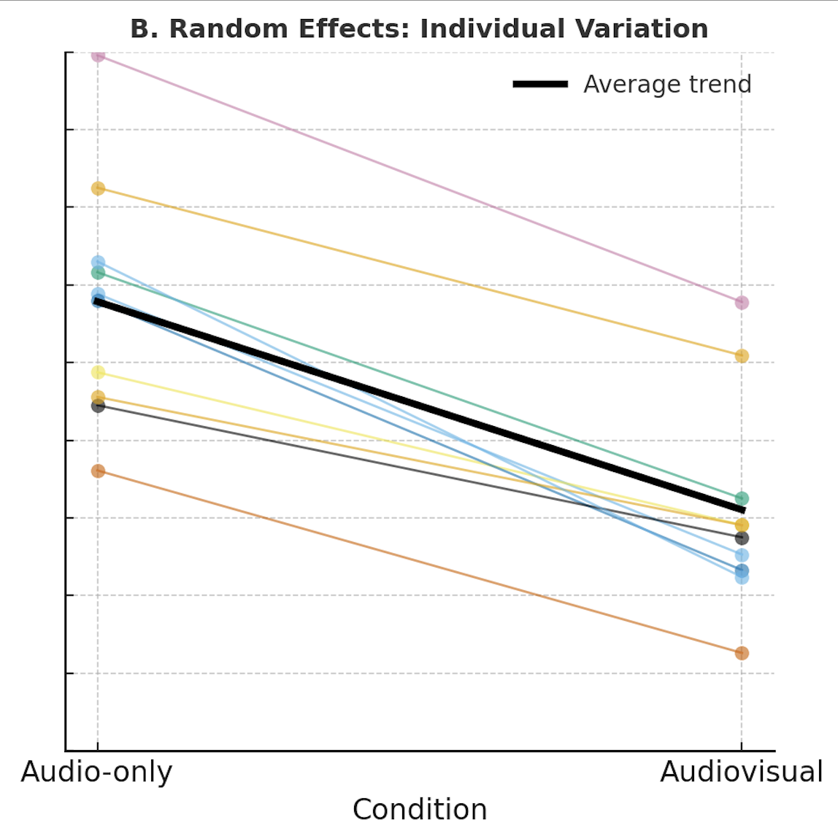
What are LMMs?
Mixed effects model = Fixed effects + Random effects.
Random Effects
Represent variability across participants, items…
Allow each participant/item to have their own trajectory regardless of the average
Account for dependent among repeated observations
Capture how much individuals/items deviate from the overall trend
Fixed Effects
Represent average, population-level relationships
Effects we expect to replicate across samples (e.g., condition differences)

Slide 11
How to choose if a variable is a fixed or a random effect?
Fixed Effects
Effects we want to estimate
Of theoretical interest
Random Effects
Sources of variability we want to account for
Of statistical necessity

Slide 12
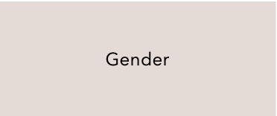
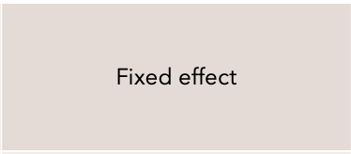
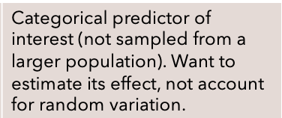
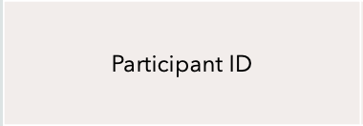
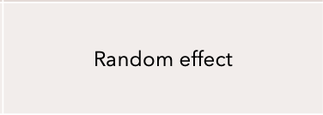
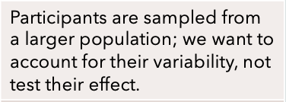






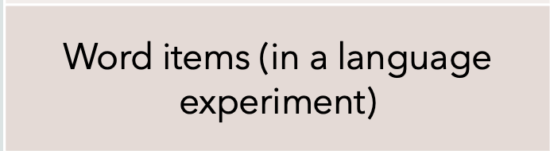

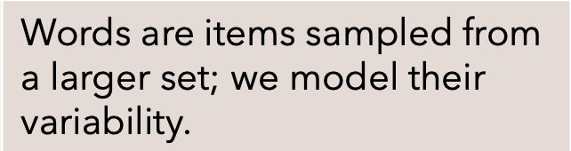
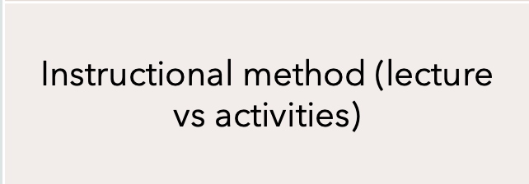
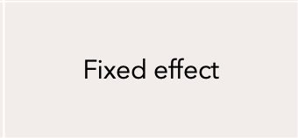
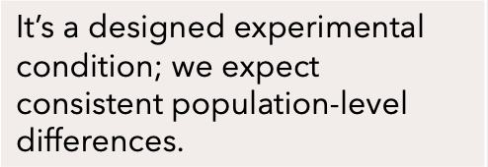
Variable | Fixed or Random? | Why?
Variable | Fixed or Random? | Why?
Gender | Fixed effect | Categorical predictor of interest (not sampled from a larger population). Want to estimate its effect, not account for random variation.
Participant ID | Random effect | Participants are sampled from a larger population; we want to account for their variability, not test their effect.
Task condition (ex: Easy vs Hard) | Fixed effect | Experimental manipulation we want to test; expected to apply across all participants.
Time (in weeks) | Fixed effect | It’s continuous, random effects can’t be continuous; we’re testing the effect of time.
Word items (in a language experiment) | Random effect | Words are items sampled from a larger set; we model their variability.
Instructional method (lecture vs activities) | Fixed effect | It’s a designed experimental condition; we expect consistent population-level differences.

Slide 13
If your variable…. | Then model it as… | Examples
If your variable…. | Then model it as… | Examples
Represents a manipulation or variable of interest you want to test | Fixed effect | Task condition, instructional methods, difficulty levels
Represents a grouping structure that creates dependence between observations | Random effect | Participants, classrooms, test items
Is continuous | Fixed effect | Time, dosage, response accuracy
Is categorical but sampled from a larger population | Random effect | Students, words… (sampled from a larger population of possible students or words)
You care about differences between levels | Fixed effect | Comparing conditions
You care about controlling variations between levels | Random effect | Accounting for individual differences
Represents a manipulation or variable of interest you want to test
Fixed effect
Task condition, instructional methods, difficulty levels
Represents a grouping structure that creates dependence between observations
Random effect
Participants, classrooms, test items
Is continuous
Fixed effect
Time, dosage, response accuracy
Is categorical but sampled from a larger population
Random effect
Students, words… (sampled from a larger population of possible students or words)
You care about differences between levels
Fixed effect
Comparing conditions
You care about controlling variations between levels
Random effect
Accounting for individual differences

Slide 14
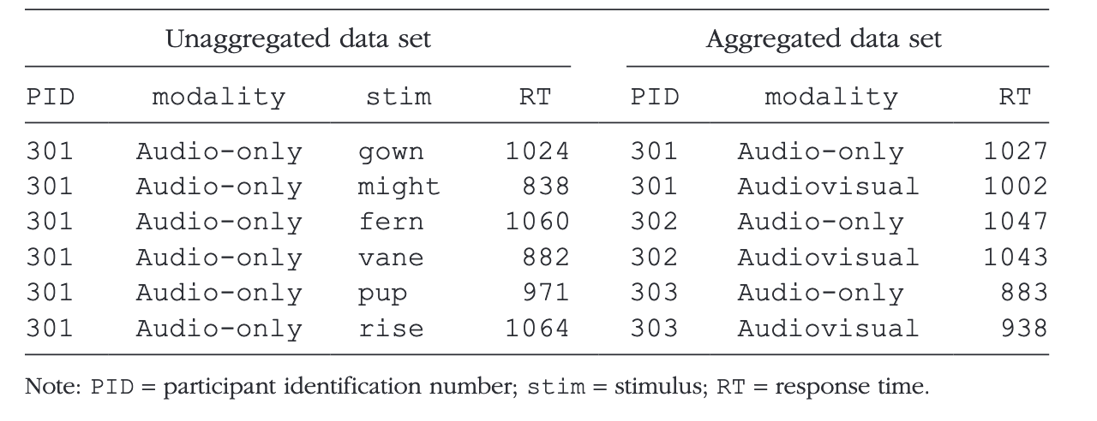
Example Data: Speech Perception Study (Brown, 2021)
53 participants
Within-subjects design
Conditions: audio-only and audiovisual.
Stimuli: 553 words (each presented in one of the 2 modalities).
Primary task: speech repetition.
Secondary task: tactile response-time classification.

Slide 15
Example data: What are our fixed and random effects?
Variable | Dependent, Fixed or Random?
Reaction time
Modality (audio-only or audiovisual)
Participants
Items (words)
Dependent variable
Fixed effect
Random effect
Random effect

Slide 16
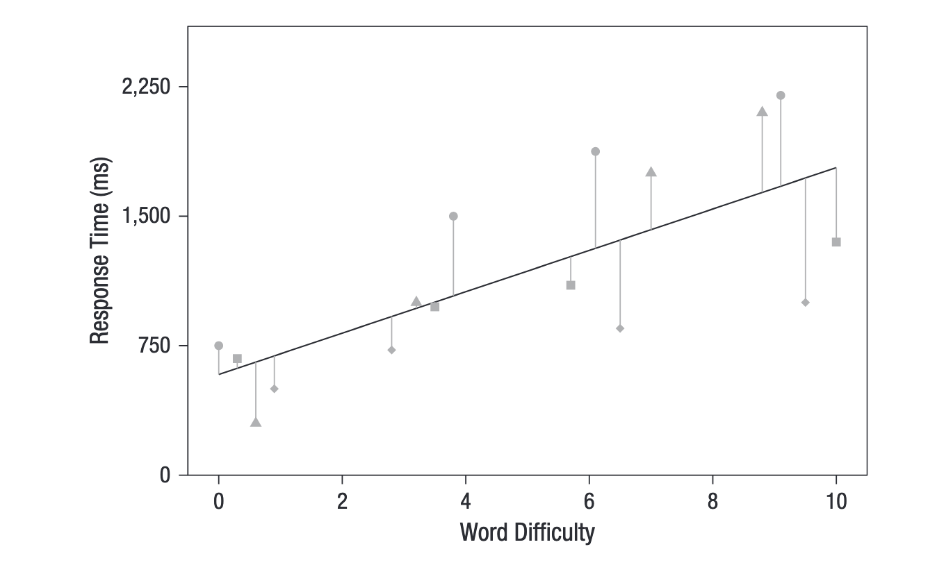
Fixed effect only model (no random effects)
One regression line for all participants → The model assumes all observations are independent
Residuals are large → Model fit is poor because participant variability isn’t modeled

Slide 17
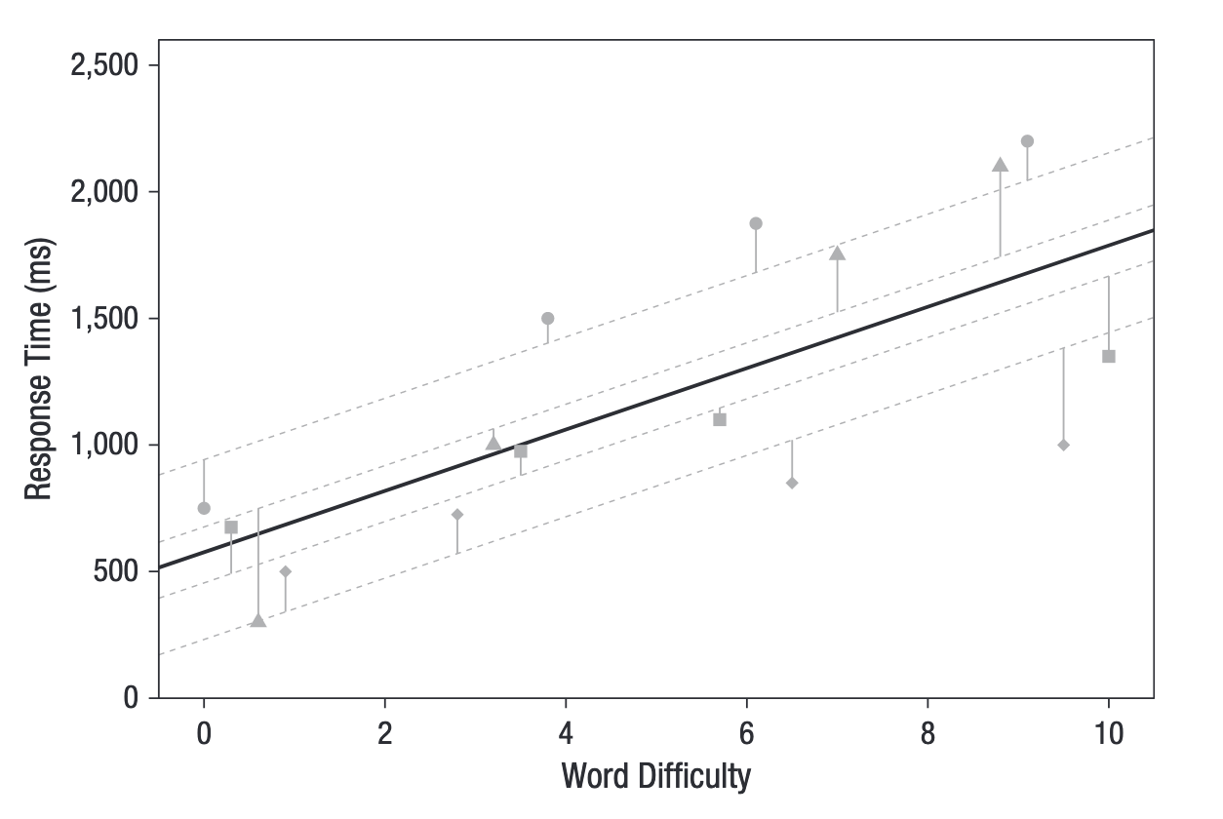
Random intercepts model for participants
Each dashed line = one participant’s predicted line
Solid black line = overall (fixed) effect
Random intercepts shift each participant’s line up or down
Residual error decreases substantially

Slide 18
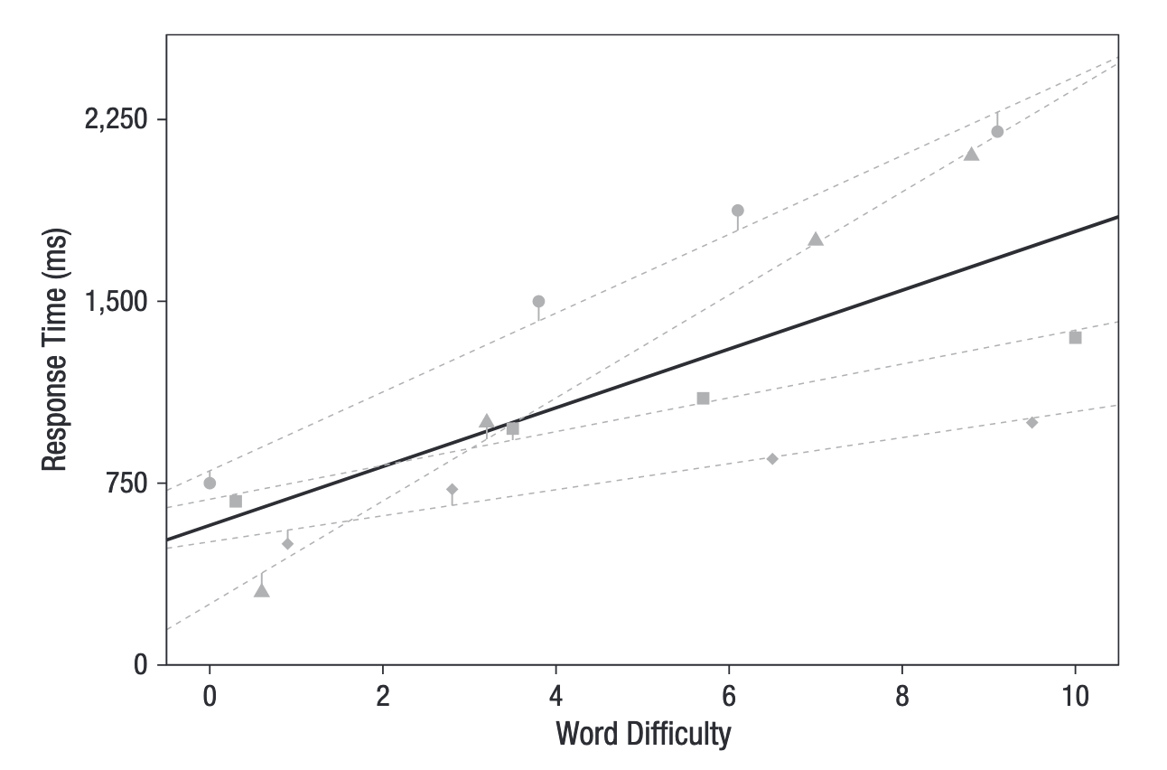
Random intercepts and slopes model for participants
Each dashed line = one participant’s predicted line
Solid black line = overall (fixed) trend
Random intercepts → Different starting points (baseline RTs)
Random slopes → Different sensitivities to word difficulty
Residual error decreases again → Better individual-level fit

Slide 19
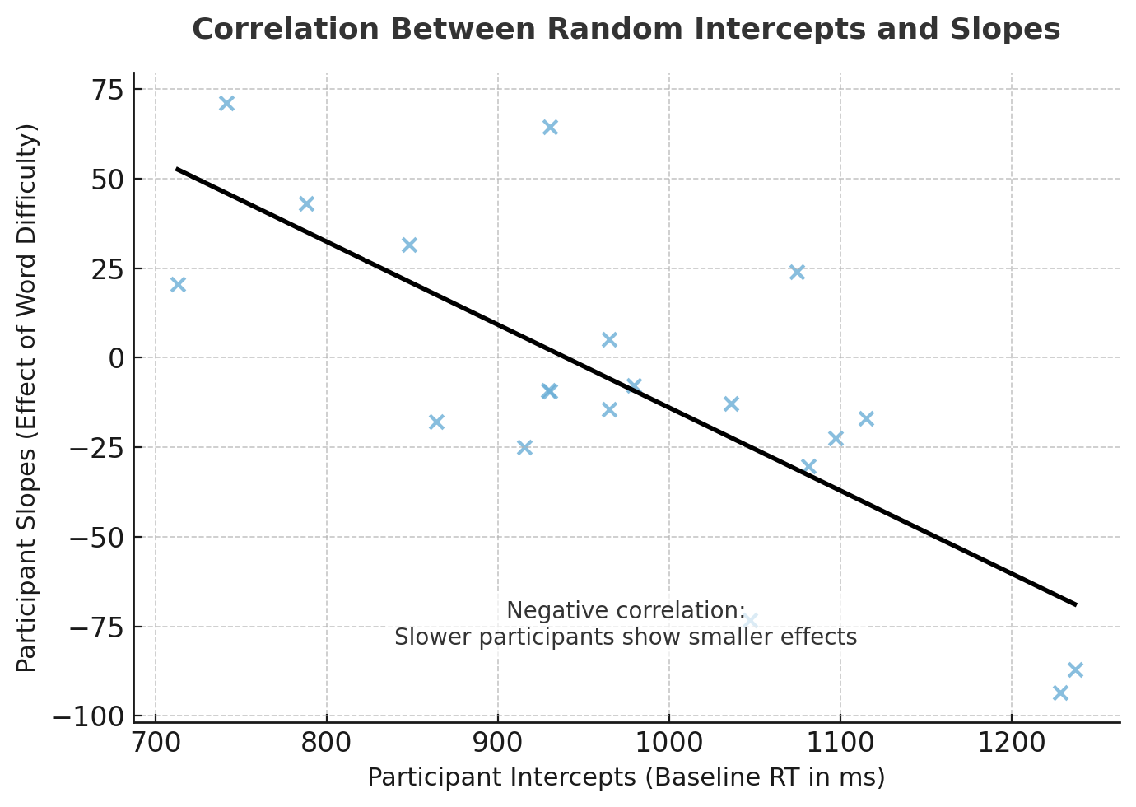
Correlations between random effects
Mixed models can estimate correlations between random intercepts and slopes → Shows whether people’s baselines relate to their sensitivity to an effect
Negative correlation: participants with higher intercepts (slower RTs) show smaller effects
Positive correlation: participants with higher intercepts show larger effects
Can reveal individual differences or ceiling/floor effects (high performers show less benefit because they’re already near ceiling)

Slide 20
Likelihood Ratio Tests (LRTs)
Likelihood: a measure of how well the model’s parameters explain the data/match the observed data.
What does it mean “the model fits the data better”?
The model makes predictions that are more consistent with the actual observations.
LRTs compare models to find the model that best fit the observed data.
Specifically, it compares simpler to more complex models

Slide 21
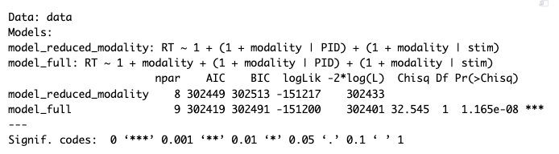
LRTs Output Interpretation
Column | Meaning | Explanation
npar | Number of parameters estimated | More parameters = more complex model
AIC/BIC | Information criteria tests (lower value = better) | Compare models based on how well they fit the data relative to how complex they are.
logLik | Log-likelihood (how probable the data are under the model) | Closer to 0 (less negative) = better fit.
-2*log(L) | Likelihood Ratio Test statistic | Measures how much the likelihood improved when adding “modality”.
Chisq | Chi square test
Df | Difference in number of parameters | 1 here, because we added one fixed effect (modality) to the full model
Pr(>Chisq) | P-value from Chi-square test | Probability that the improvement in fit happened by change. If <0.05 = significant.

Slide 22
LRTs Output Interpretation Example
Does a model that includes information about the modality in which words are presented fit the data better than a model that does not include that information?
The small p value indicates that the model including the modality effect provides a better fit for the data than the model without it; thus, the modality effect is significant.

Slide 23
Don’t fall into p-hacking!!
Full model: RT ~ modality + noise + difficulty + (1|PID)
Reduced1: RT ~ modality + noise + (1|PID)
Reduced2: RT ~ modality + difficulty + (1|PID)
Reduced3: RT ~ difficulty + noise + (1|PID)
Each fixed effect must be tested with its own reduced model.
For 3 predictors → 3 separate reduced models.
Issue!
When building reduced models, it’s tempting to “peek” at results.
You might drop or keep effects based on what looks significant.
That’s called HARKing – Hypothesizing After the Results are Known.
R can do all models comparison automatically instead!

Slide 24
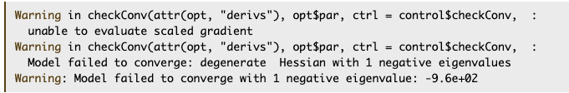
What is Convergence?
When we fit an LMM, the computer tries to find the set of parameter values (intercepts, slopes, variances, correlations, etc.) that make the model’s predictions match the data as closely as possible.
→ Optimization.
Convergence means: The search has successfully found a stable solution (the best combination of parameters given the data).
Converged model: The algorithm found numbers that make sense, the model has settled on a good solution.
Did not converge: The algorithm gave up before finding a stable set of estimates.

Slide 25
What is a singular fit?
A singular model is one that technically converged, but one or more of its random-effect variances are estimated as zero or its correlations are exactly ±1.
In other words: The model includes random effects the data don’t actually support.
What causes singularity?
Too many random effects for the amount of data.
Not enough variations to estimate separate variances.
Random effect terms that are redundant or highly correlated.
Sparse or unbalanced data (few observations per grouping level).

Slide 26
What causes a failure to converge or a singular fit?
failure to converge
singular fit
Model complexity: Too many random effects for the amount of data; overly complex random structure.
Data sparsity: Too few observation or unbalanced design.
Collinearity: Predictors or random effects are highly correlated.
Poor model specification: Mis-specified random structure or inappropriate link function.
Lack of variability: The random slope does not actually vary across subjects/items.
Over-parameterization: Too many random effects.
Redundant terms: Two random terms model the same variance source.
Sparse grouping levels: Not enough data points per random-effect level (very few trials per item).
High correlation among random effects: The intercept and slope are nearly perfectly correlated, forcing one parameter to “collapse”.

Slide 27
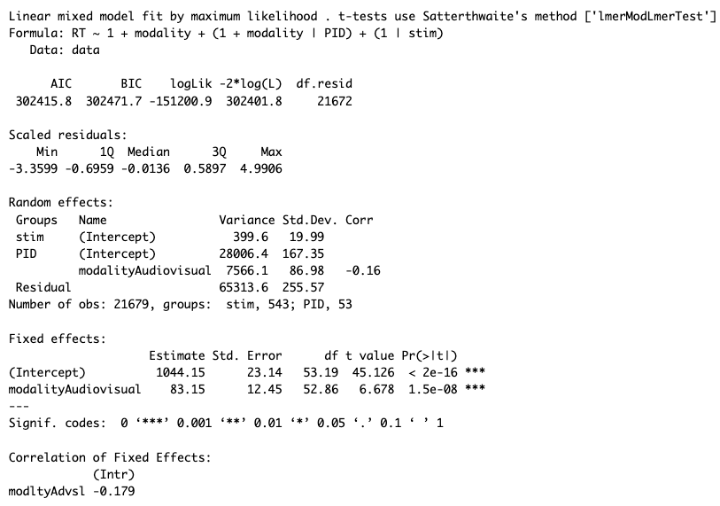
Interpreting Fixed and Random Effects
Model fit indices.
Not really useful on their own, as they are used to compare models.

Slide 28
Interpreting Fixed and Random Effects
Residuals are the differences between the model’s predictions and the actual observed values.
→ A residual of 0 means the model predicted that trial perfectly. → A large residual means the model’s prediction was off.
Scaled residuals interpretation:
Around 0 = Good fit
Around ± 1 or ± 2 = moderate deviation
Beyond ± 3 = potential outliers.

Slide 29
Interpreting Fixed and Random Effects
Stim (intercept):
Small variability (≈20 ms).
Some words slightly faster/slower.
Results are generalizable across words.
Participants (Intercept):
Large variability (≈167 ms).
Big individual differences in overall speed.
Participants (modalityAudiovisual):
Moderate variability (≈87 ms).
People differ slightly in strength of modality effect.
Correlation intercept and slope
= –0.16:
Weak relation between baseline speed and modality sensitivity.
Baseline speed and sensitivity to modality is largely independent.
Residual = 256 ms: Trial-level noise not captured by the model.

Slide 30
Interpreting Fixed and Random Effects
Intercept (1044 ms):
Predicted mean RT in the Audio-only (reference) condition.
p < .001 → significantly different from 0 (expected, not theoretically interesting).
ModalityAudiovisual (+83 ms):
Audiovisual trials were 83 ms slower than Audio-only.
p < .001 → significant effect of modality on reaction time.
Take-home:
Fixed effects show the average, population-level relationships.
On average, participants took longer to respond in the audiovisual condition, and that difference is statistically reliable.

Slide 31
Interpreting Fixed and Random Effects

Slide 32
Reporting Results in a Manuscript
Likelihood Ratio Tests
Chi-square value, df, and p-value
Fixed effects
Coefficient estimates, SE, t-values and p-values
Random effects
Random effects structure for final model
Variability: Report variance and/or SD for each random effect
Correlations between intercepts and slopes
Report R packages and their versions for reproducibility

Slide 33
Why degrees of freedom have decimals?
Degrees of freedom in LMMs are approximated, not counted exactly.
Software uses approximation methods like Satterthwaite or Kenward–Roger to estimate the effective df for each test.
These methods adjust for the correlations and random effects structure in the data.
As a result, df values are often non-integer (e.g., 32.7) — reflecting partial or weighted information.
Decimal df = the model’s best estimate of how much independent information is available for that effect.

