Slide 1
Deepfake Detection
Acoustic and prosodic characteristics of AI-generated speech
May 8th, 2026

Slide 2
Disclaimers
Any products and systems mentioned in this presentation are provided for educational and illustrative purposes only.
Mention of any specific product, manufacturer, or service does not constitute an endorsement or recommendation by the presenter or their organization. Other comparable products or systems may be available.
The presenters have no financial interest in any product mentioned in this presentation.
Any specific audio files or screenshots used in this presentation are illustrative.

Slide 3
Deep Speech Simulation, Animation, and Ethics

Slide 4
General Introduction and Background
Speech simulation and animated communication have evolved rapidly over the last decades.
Artificially generated speech and facial animation are increasingly integrated into social interaction, clinical applications, and entertainment.
Advances in AI and digital processing have made speech-driven animation more realistic and accessible.

Slide 5
Historical Background of Animation
Animation has long been used in movies and entertainment.
Early animation relied on manual synchronization of lip movements with speech.
Modern animation increasingly uses automated speech-driven facial rendering.
Speech animation now appears in movies, games, education, and healthcare.

Slide 6
Speech and Animation Synchronization Challenges
One major challenge is synchronization delay between speech and facial movement.
Lip movements often fail to align naturally with speech timing.
Articulation details may not be visually represented accurately.
Prosody, rhythm, and emotional expression remain difficult to simulate convincingly.

Slide 7
Social Media and Digital Manipulation
Visual alteration of still photographs is common in social media.
Cartoon filters and avatar systems allow altered self-representation.
Recent technologies animate still photographs in dynamic backgrounds.
Deepfake systems can alter both facial appearance and voice.

Slide 8
Good and Harmful Uses of Deep Simulation
Deep speech and visual simulation can be used for beneficial or harmful purposes.
Potential misuse includes fraud, misinformation, and identity manipulation.
Positive uses include education, healthcare, rehabilitation, and communication support.
Ethical safeguards and disclosure policies are increasingly important.

Slide 9
Examples of Positive Applications
Speech simulation is increasingly used in assistive and clinical technologies.
Examples include Siri and conversational AI systems.
Talking robots have been implemented in retirement homes in Belgium.
Speech simulation may improve interaction and reduce social isolation.

Slide 10
Talking Robots and Companion Technology
Robotic conversational systems may provide companionship in elderly care.
Potential benefits include increased communication opportunities.
Speech interaction may support fluency, speech initiation, and prosody.
Robots can assist with reminders, routines, and emotional engagement.

Slide 11
Clinical Applications
Speech-driven animation has applications in speech-language pathology.
Possible uses include AAC and voice restoration systems.
Artificial voice reconstruction may preserve personal identity in communication.
Speech simulation may support communication after severe neurological injury.

Slide 12
Voice Restoration and AAC
AAC systems increasingly incorporate personalized synthetic voices.
Voice banking allows preservation of a patient’s natural voice.
Speech synthesis may support communication after laryngectomy or neurodegenerative disease.
Future systems may incorporate realistic facial animation with speech output.

Slide 13
Speech After Death and Ethical Issues
Artificial simulation raises questions regarding speech reproduction after death.
Families may recreate voices for memorial or legacy purposes.
Ethical concerns involve consent, ownership, and authenticity.
Disclosure and regulation are increasingly necessary.

Slide 14
Need for Detection and Ethical Disclosure
Detection and assessment of simulated speech are warranted.
Listeners may not distinguish authentic from synthetic speech.
Clinical and legal settings require disclosure of simulated content.
Ethical frameworks are needed for responsible use of deep speech technologies.

Slide 15
Boutsen (2004)
Facial–Vocal Puppetry

Slide 16
Study overview
Boutsen, F. (2004). Effects of Facial-Vocal Puppetry on Speech.
College of Allied Health Research Seed Grant proposal Not funded.
Speech-driven animation of a talking head was combined with altered auditory feedback.
Voice-altered feedback was delivered through earphones.

Slide 17
Rationale for Facial–Vocal Puppetry
The study proposal drew upon findings from frequency-altered feedback research.
Frequency-altered feedback has been shown to reduce dysfluencies in stuttering.
It may also increase vocal frequency range in Parkinson’s disease.
The system targeted fluency and prosodic control in speech production.

Slide 18
Experimental Design
Two experimental scripts were developed.
Script 1 targeted gradual increases in utterance length.
Script 2 targeted focused stress assignment and prosodic variation.
The design manipulated rhythm, intonation, and speech timing demands.

Slide 19
Script 1: Natural Conversational Context
“Meet” Mabopi
Hello my name is Mabopi.
I would like you to know Mabopi.
Mabopi likes pie if Mabopi buys it.

Slide 20
Script 2: Focused Stress Assignment
“Meet” maBOpi
“and meet” MAbopi
maBOpi and MAbopi are friends
maBOpy likes pie if MAbopy buys it.

Slide 21
Anticipated Outcomes and findings
Potential benefits for fluency.
Speech-driven animation may facilitate timing and prosodic control.
Potential for speech benefits in persons with hypokinetic dysarthria.

Slide 22
Future applications
Future applications may target conversational fluency in children.
Reading fluency and prosodic training may benefit from animated feedback.
Integration with AI and real-time speech tracking is likely.
Clinical systems may eventually personalize both speech and facial behavior.

Slide 23
Conclusion
Speech-driven animation and deep speech simulation represent rapidly evolving technologies.
These systems offer substantial opportunities in communication sciences and rehabilitation.
At the same time, risks associated with deception and misuse must be addressed.
Detection systems, disclosure standards, and ethical frameworks remain essential.

Slide 24
Still, a digital divide exists
The digital divide (Dvorak and Boutsen, 2023) presents a problem in integrating and adopting/modifying solutions provided in engineering
They require
  Programming
  Signal processing competency
  Offline analysis
This divide also prevents easy adoption or creation of tools to detect deep audio fakes

Slide 25
What are deepfakes?

Slide 26
Deepfakes
Realistic visual or audio content generated using artificial intelligence tools
  Images
  Videos
  Audio (narration, podcasts)
Etymology: “deep learning” + “fake”
  Deep learning
  Fake: Depicts a scene or event that did not occur in reality
Becoming increasingly common on social media platforms
  Facebook
  YouTube
  TikTok
  Instagram

Slide 27
Benign uses of deepfakes
Visual effects and “digital actors”
  Supports independent film-makers without access to professional studios
  Allows hobbyists to access creative tools with lower budget
Art and interactive content
  Can improve audience engagement
Video game development
  Provides tools for character generation and animation
Satire, parody, and social commentary
Assistive technology (AAC speech synthesizers)
  Persons with neurological or congenital diseases (e.g., ALS, cerebral palsy)
  Voice restoration following surgery (e.g. laryngectomy)
    Pre-op: Record patient’s voice samples
    Post-op: Import voice profile into AAC / text-to-speech device

Slide 28
Malicious uses of deepfakes
Hate speech
False accusations & fabricated evidence
  Fake incriminating photos or videos
  Artificial recordings of “phone calls”
Scams
  Impersonation of family members
  Fake job interviews
  Malicious “tech support” to harvest computer credentials
Fake news and political manipulation
  Sowing distrust in institutions
  Foreign interference in elections
Engagement farming
  “AI slop” / “pod slop”: low-quality, mass-produced content
  Clickbait / ragebait: content designed to entice users to share with friends, thereby increasing ad revenue
  Especially prevalent on social-media platforms

Slide 29
Characteristics of deepfakes
Visual cues
  Unnatural facial movements
  Eye gaze inconsistencies
  Audio / visual sync errors
  Skin texture
  Background anomalies
Audio cues
  Robotic or unnatural prosody
    Monotone delivery
    Flat intonation
    Unusual cadence / timing
    Incorrect emphasis
  Mispronunciations (synthesizer unaware of word context)
  Repeating artifacts (phonemes)
  Phrasing issues (many deepfakes are generated in non-English-native countries)

Slide 30
How did we get here? A brief history of speech synthesis

Slide 31
1950s-1960s
Foundations and Early Experiments
1952-1954: Bell Labs & “Dudley’s Vocoder”
  Homer Dudley at Bell Labs developed the Vocoder, a device that could analyze and synthesize speech signals, primarily for telecommunications and experimental speech synthesis.
1961: IBM Shoebox & Early Computer Speech
  IBM began experimenting with computers that could recognize and reproduce simple speech patterns.
Strengths
  Demonstrated that machines could produce intelligible speech.
  Allowed experimentation with phonemes, vowels, and consonants.
  Could convey basic words or phrases.
Weaknesses
  Very robotic and monotone (lacked natural prosody).
  Limited vocabulary: usually pre-programmed words or simple syllables.
  Low intelligibility in continuous speech.

Slide 32
1960s-1970s
Formant-Based Synthesis
1968: “Daisy Bell” Computer Song
  Using formant synthesis, an IBM 704 computer sang “Daisy Bell.”
  This became iconic in the history of speech synthesis.
1970: DECtalk Development Begins
  Researchers at Digital Equipment Corporation worked on DECtalk, one of the first widely known text-to-speech (TTS) systems.
Strengths
  Could generate continuous speech from arbitrary text.
  Basic control over pitch, duration, and intonation.
  Efficient in terms of computation for the time.
Weaknesses
  Still “robotic”.
  Sounded artificial and monotone.
  Prosody was often unnatural.
  Rhythm and stress patterns were awkward.
  Users found it hard to convey emotion or emphasis.

Slide 33
1980s
Concatenative and Rule-Based Methods
1980s: Formant and Articulatory Models
  Speech synthesis moved from purely mathematical models to more rule-based and articulatory approaches, simulating how the human vocal tract produces sounds.
  Example: Klatt synthesizer (Klatt, 1980)
1984: MITalk
  Developed at MIT, this system synthesized relatively intelligible speech from arbitrary text using rules for phonetics and prosody.
Strengths
  More natural-sounding than prior approaches.
  Could reproduce actual human recordings, improving voice quality.
  Better rhythm and stress patterns when combining speech units.
Weaknesses (of concatenative)
  Limited by pre-recorded databases.
  Rare words or unusual phrases could be distorted.
  Glitches at concatenation points could make speech sound “jumpy”.
  Difficult to modify pitch or speaking style flexibly.

Slide 34
1990s
Concatenative synthesis
1990s: Unit Selection Synthesis
  Advances in digital signal processing allowed speech synthesis to select pre-recorded units (phonemes, syllables, words) and stitch them together for natural-sounding speech.
1990: DECtalk Released Publicly
  DECtalk became widely known, even famously providing the voice for Stephen Hawking.
Strengths
  High intelligibility and much more natural prosody.
  Could generate speech with regional accents or expressive intonation.
  Good for TTS systems with large, well-annotated corpora.
Weaknesses
  Huge (for the time) storage requirements for speech databases.
  Occasional “hiccups” when suitable units weren’t available.
  Limited flexibility for novel intonation or emotional expression.

Slide 35
2000s-2010s
Statistical and Machine Learning Approaches
2000s: HMM-Based Synthesis (Statistical Parametric)
  Hidden Markov Models (HMMs) allowed TTS systems to generate smoother and more flexible speech by statistically modeling acoustic features.
2006: Festival and eSpeak
  Open-source platforms like Festival (University of Edinburgh) and eSpeak enabled more accessible TTS development and experimentation.
Strengths
  Flexible, compact, and capable of generating new speech patterns.
  Could smoothly interpolate between different speech sounds.
  More controllable parameters (speed, pitch, emphasis).
Weaknesses:
  Often sounded muffled or lacked natural clarity.
  Less natural than unit selection for long stretches of speech.
  Emotion and expressiveness were limited.

Slide 36
2010s
Neural Network Revolution
2013: WaveNet (DeepMind)
  DeepMind introduced WaveNet, a neural network capable of generating highly natural-sounding speech waveforms directly from text.
2017: Tacotron & Tacotron 2 (Google)
  End-to-end neural TTS models improved prosody, intonation, and naturalness, producing near-human quality speech.
2018: Transfer Learning for Voice Cloning
  Neural methods enabled voice adaptation and cloning from just a few seconds of sample audio.
Strengths
  Highly natural, often near-human quality.
  Excellent prosody, intonation, and timing.
  Capable of expressive speech and voice cloning.
  End-to-end systems could generate speech from raw text without handcrafted rules.
Weaknesses
  Computationally intensive.
  Could produce occasional artifacts or mispronunciations in unusual words.
  Some voices could sound “too perfect”.
  Slightly uncanny in emotional subtlety.

Slide 37
2020s
Modern AI-Driven Speech Synthesis
2020-2021: Multilingual & Expressive TTS
  Models like VALL-E and Meta’s AudioLM could synthesize speech in multiple languages with expressive prosody.
2022-2023: Generative AI and Chatbots with Speech
  AI systems like OpenAI’s GPT + TTS integrations, ElevenLabs, and Murf.ai allow real-time speech generation with lifelike voices and customizable styles.
2024-2025: Diffusion-Based Audio Synthesis
  Recent AI research uses diffusion models for highly realistic, expressive, and controllable voice generation.
Strengths
  Extremely realistic and expressive, even for very short input samples.
  Can mimic accents, emotions, and individual speaker styles.
  Supports multilingual output and dynamic style adaptation.
  Capable of real-time generation for conversational AI.
Weaknesses
  Requires large training datasets and computational power.
  Potential ethical concerns (voice cloning, deepfakes).
  Occasional subtle glitches in rare or out-of-distribution speech contexts.
  “Uncanny valley” effect and negative consumer sentiment.

Slide 38
Prosody in natural speech
Reflects organization and planning
Intrinsic prosody
  Phoneme attributes (duration)
  Syllable structure
  Inherent word stress
  Grammatical constructs
    Phrases
    Constituents
    Embedding
Extrinsic prosody
  Emphasis
  Pragmatics
  Paralinguistic communication
  Emotional affect
  Execution (hesitation, backspacing, rephrasing)

Slide 39
Prosody in synthesized speech
Typically an afterthought
Rule-based prosody
  Manual coding for pitch, duration, and intensity
  Predictable, but difficult to scale
Modification post concatenative synthesis
  Apply pitch scaling or duration adjustment after synthesis of “flat” concatenated structure
  Limited by recorded units and can generate mismatches
Neural network based TTS
  Predict mel spectrograms to generate more natural prosody
  Computationally intensive (may not be suitable for mobile devices)

Slide 40
What can we do about it?

Slide 41
Education and training
Awareness and media-literacy programs
  Promote deepfake awareness in consumers
  Strengthen critical listening skills
    Unusual prosody
    Unnatural intonations
    Contextual verification (sources, identity, motive)
  Examples
    News Literacy Project
    MIT Media Lab
    Online courses on digital forensics

Slide 42
Technological tools
Downloadable software
  Download tool to desktop computer
  Open target file and view output
  Examples
    Microsoft Video Authenticator
    iZotope RX
Online platforms / apps
  Upload target file or link
  Receive report on authenticity or reasons behind deepfake classification
  Examples
    resemble.ai
    Pindrop Pulse

Slide 43
Audio deepfake detection
Spectral analysis
Phase and temporal analysis
Statistical and Noise-Based Features
Phase-Coherence and Harmonic Structure
Prosody and Pitch Contour Analysis
Vocoder / Synthesis Artifact Detection
Cross-Domain or Multi-Representation Analysis
Transmission and Compression Artifacts

Slide 44
Spectral Analysis
Examination of the frequency content of the signal to detect unusual patterns
Examples
  Spectrogram irregularities: Deepfake voices sometimes produce unnatural spectral envelopes or harmonic structures.
  Formant inconsistencies: Human voices have consistent formant transitions; deepfakes can have abrupt or unrealistic shifts.
  Mel-Frequency Cepstral Coefficients (MFCCs): These summarize spectral shapes and are commonly used as features for deepfake classification.
  Linear Predictive Coding (LPC) Residuals: LPC captures vocal tract characteristics. Deepfakes may leave abnormal residual patterns.

Slide 45
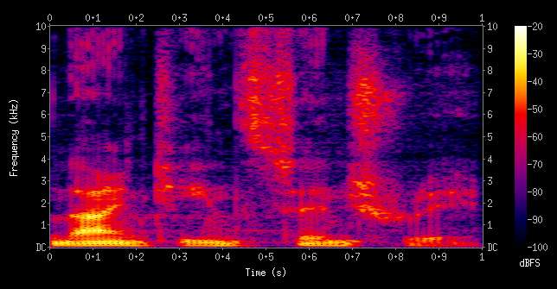
Example spectrogram
“nineteenth century”
Image: Aquegg, Public Domain, https://commons.wikimedia.org/w/index.php?curid=5544473

Slide 46
Phase and temporal analysis
Humans produce speech with natural phase and temporal relationships; deepfakes often fail to fully reproduce these subtleties.
Examples
  Group delay and instantaneous frequency: Synthetic voices may have phase anomalies detectable in the group delay domain.
  Temporal jitter and micro-timing: Subtle timing variations in real speech (like micro-pauses, pitch modulation) may be missing or too regular in fakes.
  Waveform fine structure analysis: Tiny inconsistencies in waveform shapes, especially in plosives or fricatives, can signal synthetic origin.

Slide 47
Statistical and Noise-Based Features
Real audio contains natural noise, channel artifacts, and stochastic variation that are hard to perfectly model.
Examples
  Spectral flatness / entropy: Deepfake audio may be overly smooth, lacking natural variability.
  Noise floor characteristics: Real recordings often have microphone/environment noise; deepfakes may have uniform low-level noise or none at all.
  Higher-order statistics: Skewness, kurtosis, and cross-band correlations can reveal synthetic generation patterns.

Slide 48
Phase-Coherence and Harmonic Structure
Natural speech harmonics are phase-coherent; synthetic voices often introduce subtle inconsistencies.
  Phase coherence: Integer multiples of the fundamental frequency follow natural patterns due to the physics of vocal fold vibration.
Examples
  Harmonic-to-noise ratio (HNR) analysis: Measures periodicity vs. noise; deepfakes may have unnaturally clean harmonics.
  Inter-harmonic phase relationships: Deviations can indicate synthesis artifacts.
  STFT overlay: Color coding of phase over a short-time Fourier transform spectrogram can reveal sudden jumps in artificial speech

Slide 49
Prosody and Pitch Contour Analysis
Real human speech has natural variation in pitch, intensity, and duration. Artificial speech has unnatural or less-natural variation in these dimensions.
Examples
  Pitch jitter & shimmer: Variations in frequency and amplitude can expose artificial regularity.
  Intonation contour consistency: Deepfakes may produce flattened or mechanically regular prosody.
  Speech rate anomalies: Uniform syllable durations can indicate synthetic timing.

Slide 50
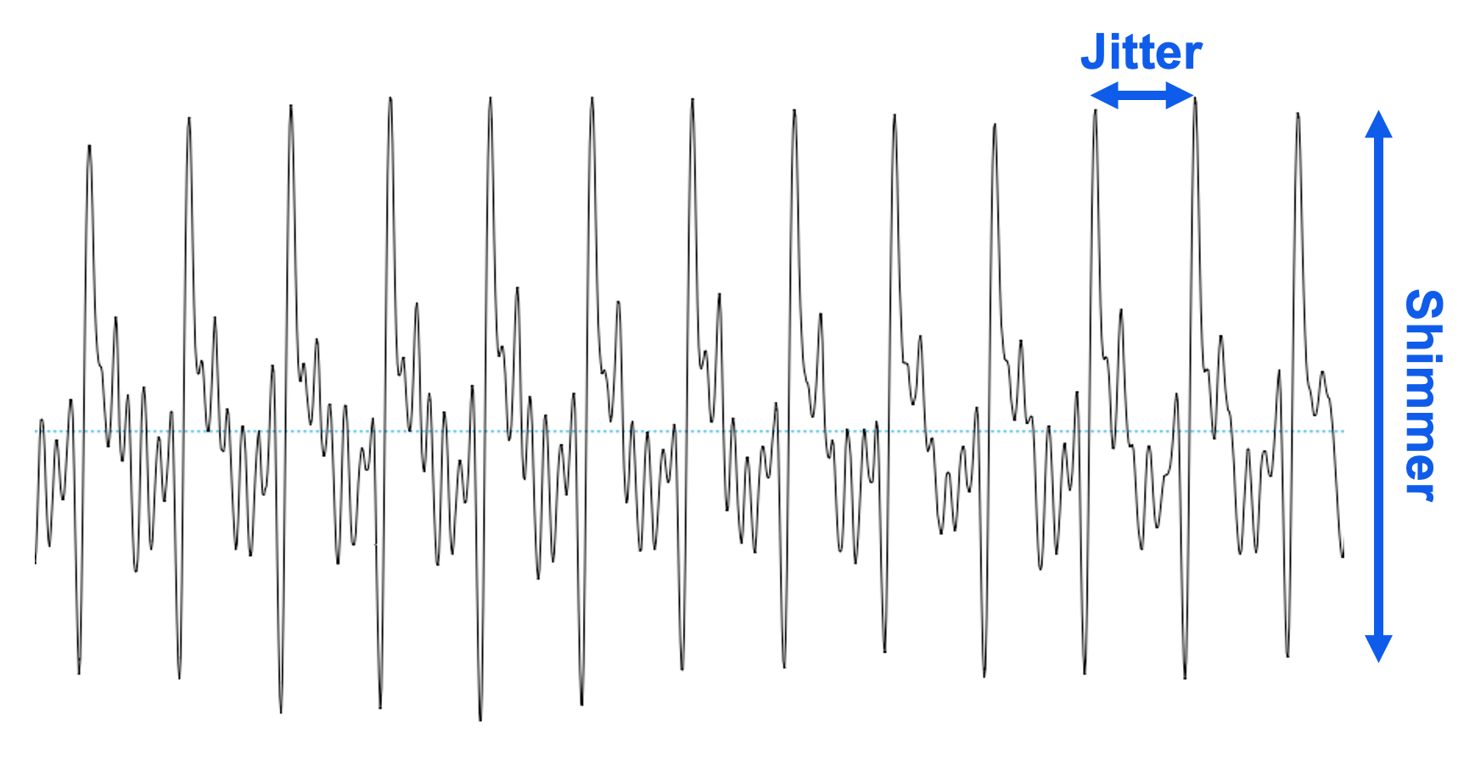
Example of jitter and shimmer
Image: Tom Bäckström (https://wiki.aalto.fi/spaces/ITSP/pages/203118974/Jitter+and+shimmer)

Slide 51
Vocoder / Synthesis Artifact Detection
Most neural TTS or voice conversion systems use vocoders, which leave distinct fingerprints.
Examples
  Envelope distortion: Vocoders may smooth or slightly distort the spectral envelope.
  Glottal source modeling artifacts: Inaccurate modeling of glottal pulses produces subtle waveform irregularities.
  Phase vocoder artifacts: Minor detuning or phase misalignment detectable in short-time Fourier analysis.

Slide 52
Cross-Domain or Multi-Representation Analysis
Combining multiple representations of the same signal increases detection reliability.
Examples
  Time-frequency fusion: Waveform + spectrogram + MFCC features improve robustness.
  Cepstral vs. waveform residuals: Comparing features from different domains can highlight synthesis artifacts.
  Deep learning embeddings: Neural networks can learn subtle signal-processing-based inconsistencies that are hard to model manually.

Slide 53
Transmission and Compression Artifacts
Audio recorded in the real world with physical equipment undergoes channel and encoding distortions that deepfakes may fail to emulate.
Examples
  MP3/Opus compression patterns: Inconsistencies in quantization noise or block artifacts can signal synthetic content.
  Room impulse response simulation: Lack of realistic reverberation or mismatched early/late reflections may expose deepfake or manipulated audio.

Slide 54
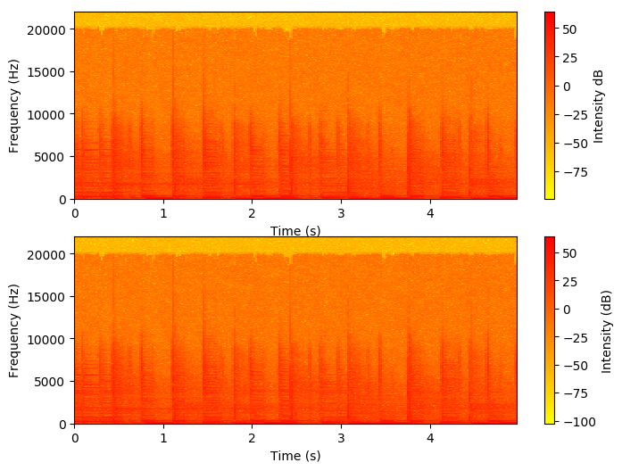
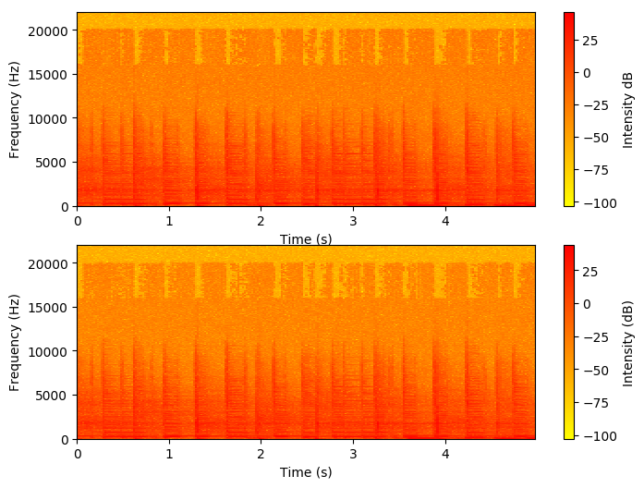
Example compression artifacts
“high quality” MP3 compression
“low quality” MP3 compression
Image: peguerosdc (https://dsp.stackexchange.com/questions/58816/how-to-interpret-these-mp3-spectrums)

Slide 55
Future directions
Incorporation of multiple metrics in machine-learning approaches
  Feature selection
  Classification-tree approach to separate real speech vs. deepfakes
Expanded web apps and dashboards
  Built-in app tutorials for new users unfamiliar with signal processing
Real-time deepfake detection
  Stop malicious uploads to social media platforms
  Verify human presenters and attendees

Slide 56
Questions?

